Slide 1
ICS3C0 / ICS4C0 (Grade 11 / 12 Computer Science)
Mr. Nestor
(gregory.nestor@peelsb.com)
(p0079141@pdsb.net)

Slide 2
Module A1.1 – Sep 06
Agenda
Attendance / Introductions
Module A1.1 - Nethack Game – Level 2
Debrief Questions
Upcoming
Tomorrow: Nethack Level 3

Slide 3
Resources
Nethack Online
https://alt.org/nethack/
Nethack Guidebook
Nethack Open Source
https://github.com/NetHack/NetHack

Slide 4
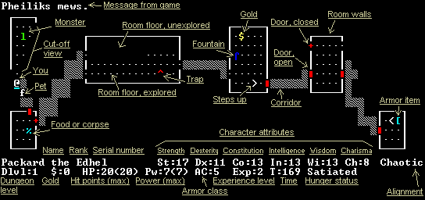
Debrief – Level 1
How many levels have you done? (How many times did you die?)
What have you found out so far…
Monsters
Special Items
Useful Commands

Slide 5
Debrief – Level 1 (Cont’d)
Does the primitive display limit the game?
How is the game more complex or less complex than modern games?

